Slide 1
Regularization and model selection

Slide 2
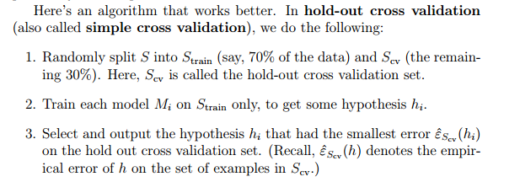
Cross validation

Slide 3
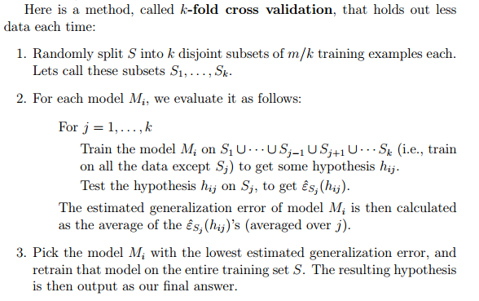

Slide 4
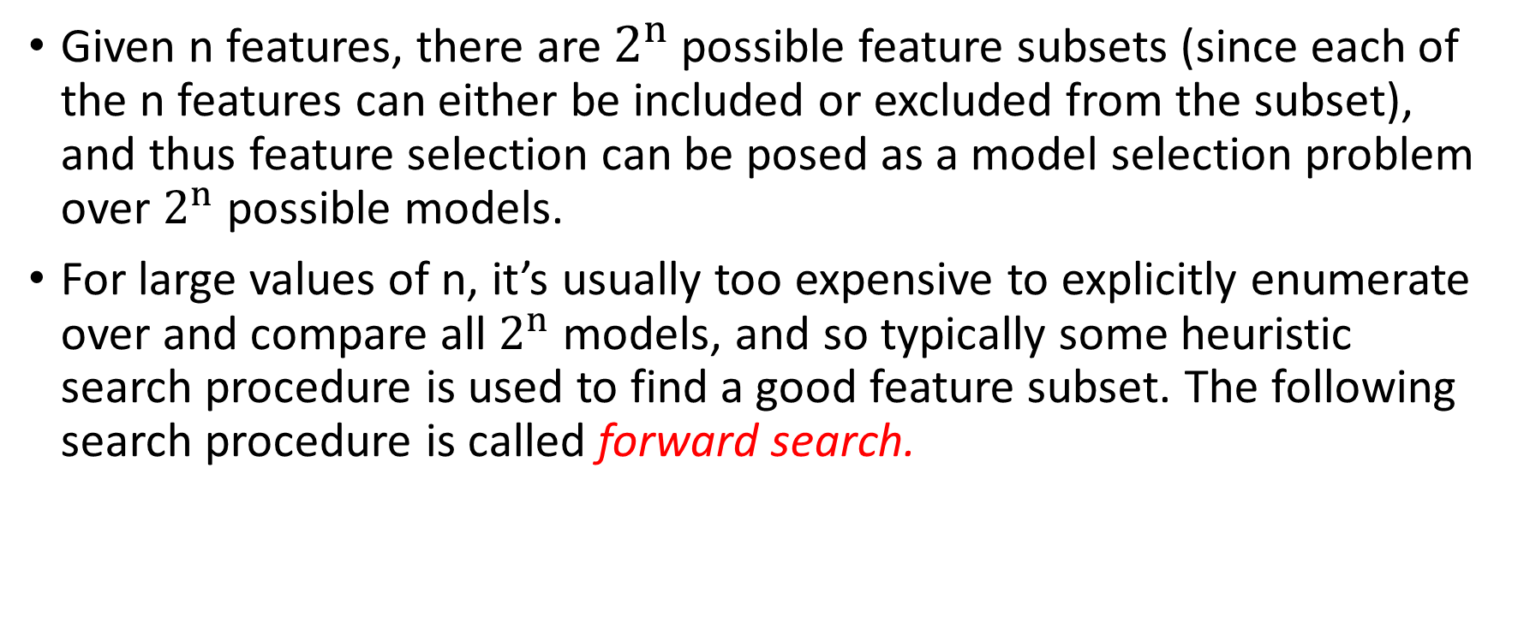
Feature Selection
Given n features, there are $2^{n}$ possible feature subsets (since each of the n features can either be included or excluded from the subset), and thus feature selection can be posed as a model selection problem over $2^{n}$ possible models.
For large values of n, it’s usually too expensive to explicitly enumerate over and compare all $2^{n}$ models, and so typically some heuristic search procedure is used to find a good feature subset. The following search procedure is called forward search.

Slide 5
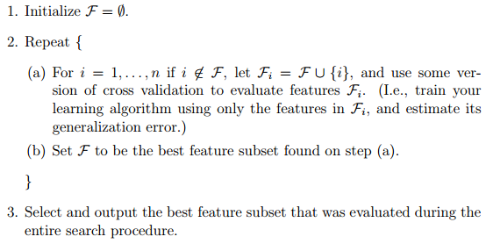

Slide 6
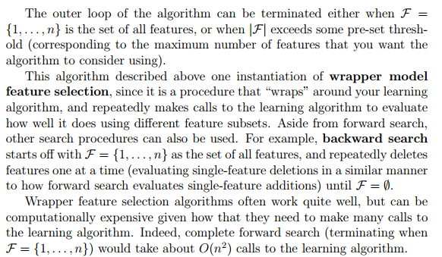

Slide 7
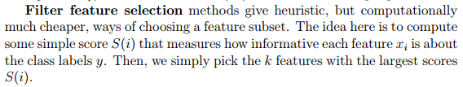
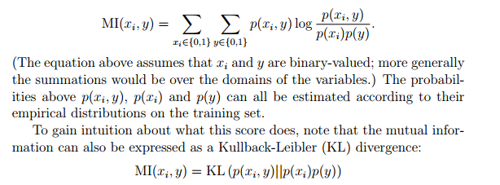
Mutual Information

Slide 8
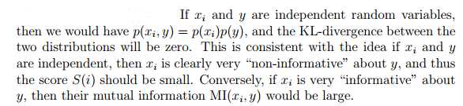

Slide 9
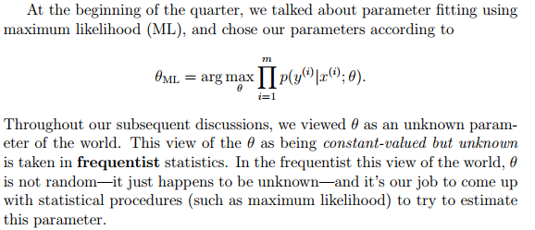
Bayesian statistics and regularization

Slide 10
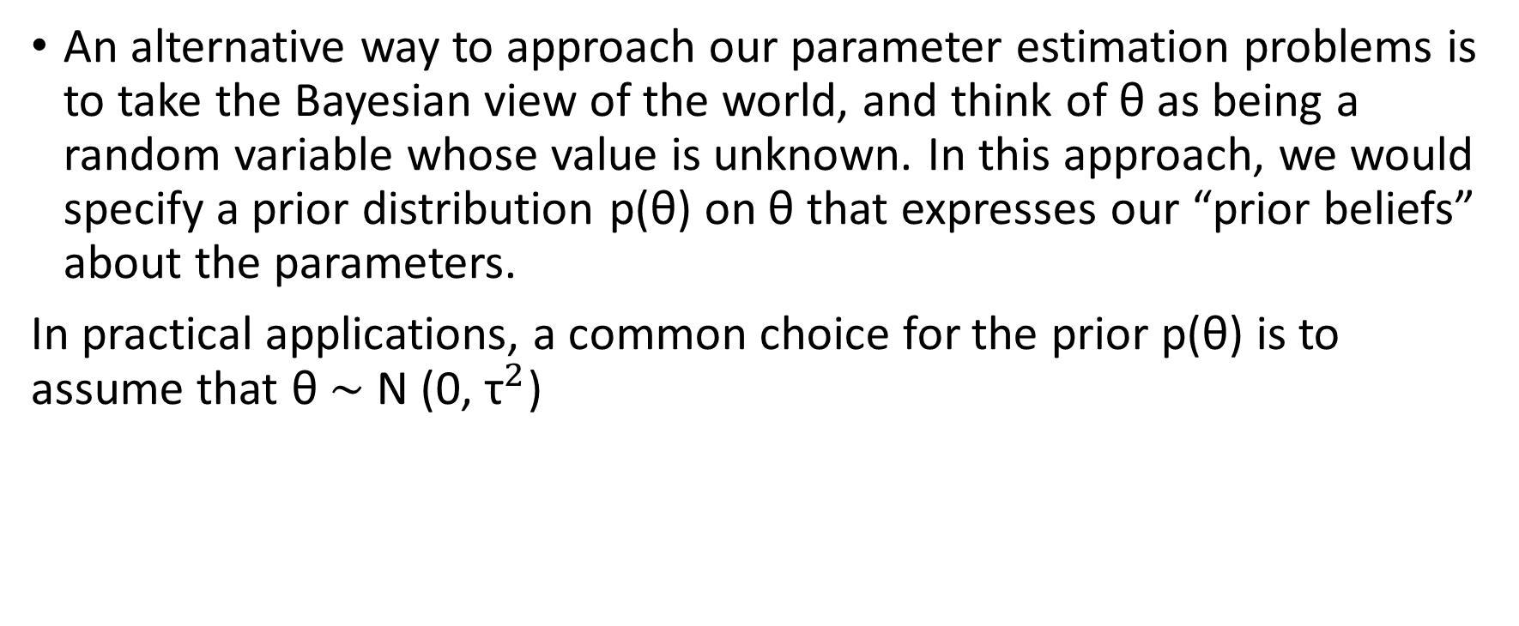
An alternative way to approach our parameter estimation problems is to take the Bayesian view of the world, and think of θ as being a random variable whose value is unknown. In this approach, we would specify a prior distribution p(θ) on θ that expresses our “prior beliefs” about the parameters.
In practical applications, a common choice for the prior p(θ) is to assume that θ ∼ N (0, ${\text{τ}}^{2}$)

Slide 11
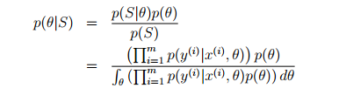
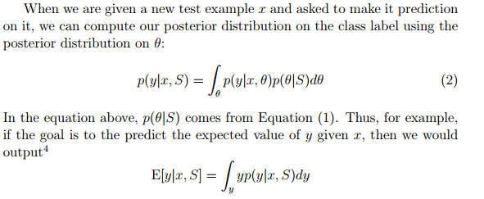
the posterior distribution on the parameters

Slide 12

Unfortunately, in general it is computationally very difficult to compute this posterior distribution.
Thus, in practice we will instead approximate the posterior distribution for θ.
The MAP (maximum a posteriori) estimate for θ is given by

Slide 13
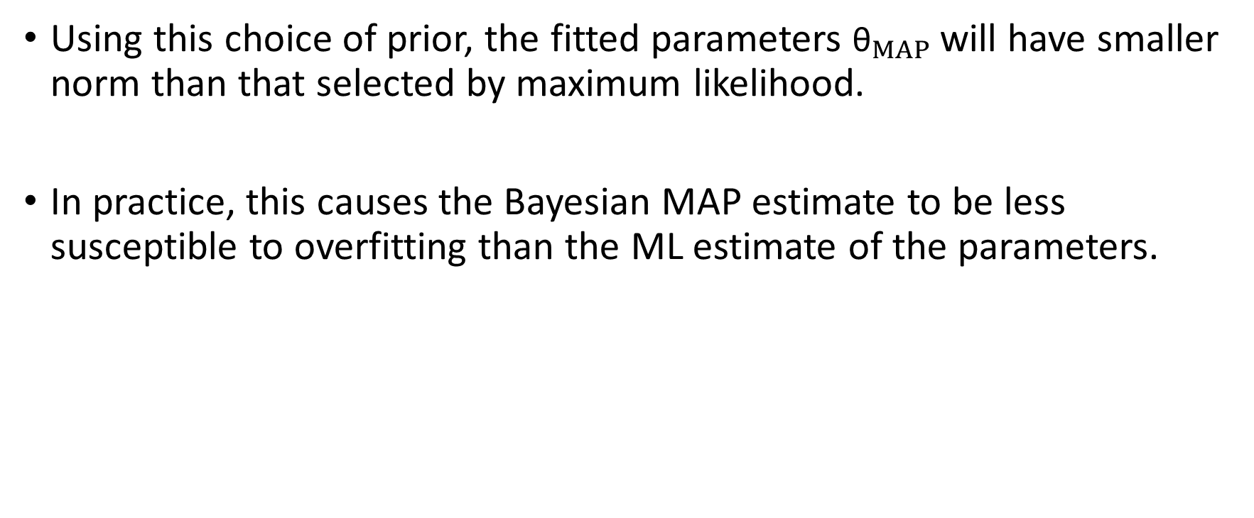
Using this choice of prior, the fitted parameters ${\text{θ}}_{MAP}$ will have smaller norm than that selected by maximum likelihood.
In practice, this causes the Bayesian MAP estimate to be less susceptible to overfitting than the ML estimate of the parameters.

